Slide 1


Machine Downtime Optimization
Name: Shivank Dwivedi
Work Experience: Data Analyst Intern in 360DigitMG.
Skills: MySQL, Power BI, Python and Excel.
LinkedIn: Linkedin Profile
GitHub: GitHub Profile
Email: shivankkdwivedi697@gmail.com

Slide 2
Contents
Business Objective
Business Constraints
Project Architecture - Data Flow Diagram
Data Collection
Exploratory Data Analysis
Data Visualization
Notes:
Change

Slide 3
Business Problem
To address the issue of unplanned machine downtime as it leads to significant productivity losses, impacts delivery schedules, breakdown, issue in machinery and increases maintenance costs. This project intends to reduce downtime by at least 10%, ultimately contributing to cost savings of $1 million or more.
KEY ISSUES
Unplanned Downtime: Machines breaking down unexpectedly due to lack of predictive maintenance.
Production Inefficiencies: Downtime reduces the overall efficiency of the production cycle.
High Costs: Emergency repairs, replacement parts, and labor costs increase when downtime is not optimized.
Data Utilization: Companies often have data from sensors and logs but lack the means to analyze and derive actionable insights.

Slide 4
Project Overview and Scope
Objective:
The primary objective of this project is to analyze machine downtime data and provide actionable insights to minimize unplanned downtime and enhance operational efficiency.
This involves identifying key variables affecting downtime, performing statistical analysis, and leveraging data visualization to support decision-making.
Process:
Data Collection: Acquired datasets from reliable sources related to machine operations.
Data Upload and Management: Imported data into MySQL for efficient querying and processing.
Exploratory Data Analysis (EDA): Performed statistical calculations like mean, median, mode, skewness, etc., to understand downtime patterns and trends.
Insights and Recommendations: Identified areas for improvement based on findings.

Slide 5
Project Overview and Scope
Tools and Technologies Used:
Database: MySQL for data management and calculations.
Languages: SQL for queries and Python.
Analysis: Statistical techniques for insights. In SQL and Python.
Expected Outcome:
Reduction in unplanned machine downtime.
Improved decision-making for maintenance and production scheduling.
Cost savings and enhanced equipment efficiency.

Slide 6
Data Dictionary
VARIABLE NAME | DESCRIPTION
Hydraulic_Pressure | The pressure level of the hydraulic system in the machine, measured in PSI
Coolant_Pressure | The pressure of the coolant system, ensuring optimal cooling of machine components.
Air_System_Pressure | The pressure within the air system, crucial for pneumatic operations.
Coolant_Temperature | The temperature of the coolant fluid used to dissipate heat from machine components.
Hydraulic_Oil_Temperature | The temperature of the hydraulic oil, indicating the operating condition of the hydraulic system.
Spindle_Bearing_Temperature | The temperature of the spindle bearings, reflecting potential overheating or wear.
Tool_Vibration | The vibration levels in the tool, which can indicate improper tooling or wear.

Slide 7
Data Dictionary
VARIABLE NAME | DESCRIPTION
Spindle_Speed | The rotational speed of the spindle, measured in RPM.
Voltage | The electrical voltage supplied to the machine during operation.
Torque | The amount of torque generated, critical for machine performance and load handling.
Cutting | Represents cutting parameters such as depth, force, or material removed during operations.

Slide 8
Exploratory Data Analysis [EDA]
STATISTICAL INSIGHTS
Hydraulic Pressure:
Mean: 101.47, Standard Deviation: 30.28, Median: 97.0
Consistent pressure with acceptable variations.
Spindle Speed:
Mean: 20,274.79, Standard Deviation: 3,852.66, High Variance: 14,842,990.0
Significant fluctuations observed.
Coolant Temperature:
Mean: 18.61, Standard Deviation: 8.52, Median: 21.0
Moderate fluctuations.
Voltage:
Mean: 348.99, Standard Deviation: 45.37
Stable with minor dips to 337V.
Tool Vibration:
Mean: 25.46, Standard Deviation: 6.44
Occasional spikes.
Notes:
EDA is used for seeing what the data can tell us before the modeling task.
Change

Slide 9
Exploratory Data Analysis [EDA]
BUSINESS INSIGHTS
Maintain Hydraulic Pressure:
Ensure routine maintenance to sustain stability and avoid unexpected breakdowns.
Optimize Spindle Speed:
Investigate causes of variance and regulate speed to minimize stress on components.
Enhance Cooling System Efficiency:
Address moderate fluctuations in Coolant Temperature to prevent overheating.
Stabilize Power Supply:
Prevent occasional voltage dips by improving electrical system stability.
Regularly Inspect Vibration Levels:
Monitor spikes in tool vibration to maintain equipment precision and avoid wear.
Notes:
EDA is used for seeing what the data can tell us before the modeling task.
Change

Slide 10
Data Preprocessing
Data Cleaning:
Checked for missing values and replaced them with appropriate measures.
Removed duplicates
Ensured consistent formatting for all entries.
Data Transformation:
Normalized/Standardized numerical columns.
Converted data types to ensure compatibility with SQL
Identified outliers using statistical methods.
Data Validation:
Verified dataset consistency after cleaning.
Ensured there were no logical errors.
Tools Used:
Python: For initial data exploration and cleaning.
MySQL: For querying and preprocessing directly in the database.
Notes:
Keep observations

Slide 11
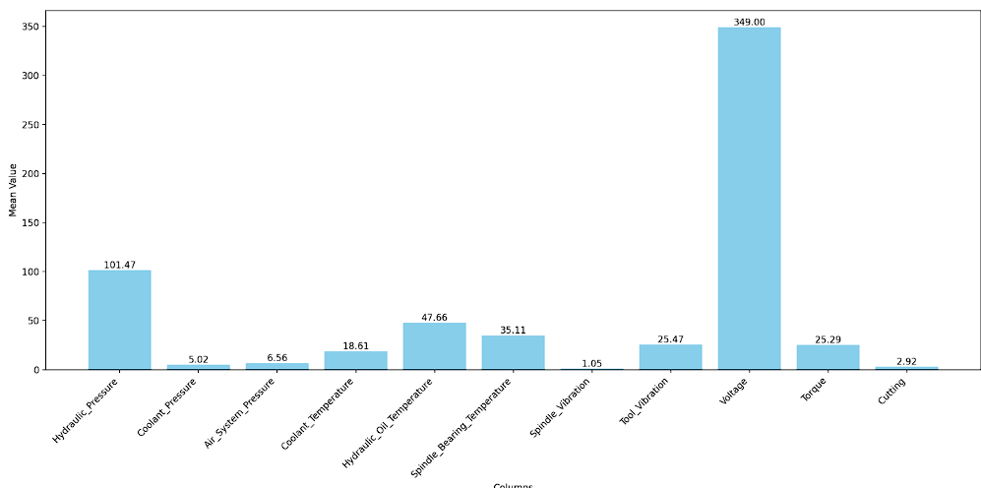
Data Visualization
Voltage exhibits the highest mean value (349.00) among all variables, indicating its dominance in magnitude compared to other factors.
Hydraulic Pressure has the second-highest mean (101.47), highlighting its importance in machine operations and the need for stable pressure conditions.
Coolant Pressure, Air System Pressure, and Coolant Temperature have relatively low mean values (below 20), indicating their lower magnitude during normal operations.
Spindle Vibration has a significantly low mean (1.05), suggesting that vibrations in the spindle are minimal under regular conditions, likely to ensure smooth performance.
Cutting has a mean value of 2.92, which may correlate with the cutting tool’s minimal operation during the data collection period.
Notes:
Add graphical

Slide 12
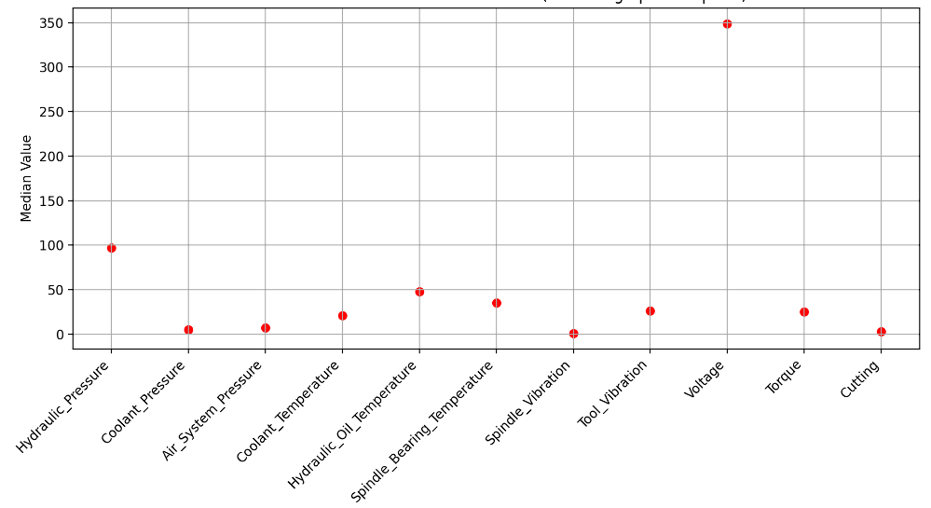
Data Visualization
Hydraulic Pressure maintains a high median value, closely aligning with its mean. This indicates consistent pressure levels without significant outliers affecting the data.
Voltage also shows a high median value, comparable to its mean, reinforcing that voltage levels are steady and evenly distributed across the dataset.
Coolant Pressure, Air System Pressure, and Coolant Temperature exhibit low median values, suggesting that these parameters are generally stable and clustered toward lower ranges.
The medians of Spindle Vibration and Tool Vibration are notably low, reflecting their minimal operational variation.
Cutting and Torque have relatively low medians, indicating that their distribution skews toward smaller values for most observations.
Notes:
Add graphical

Slide 13
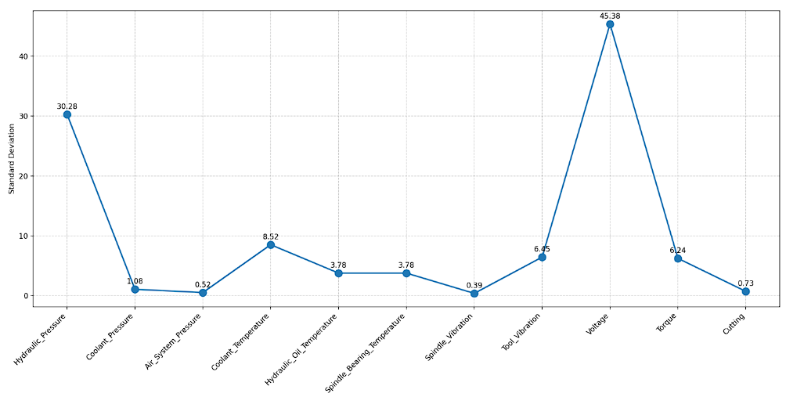
Data Visualization
Voltage exhibits the highest standard deviation (45.38), indicating significant variability in voltage values. This could suggest fluctuating conditions that may impact machine stability.
Hydraulic Pressure shows the second-highest standard deviation (30.28), reflecting moderate variability that might require regular monitoring to ensure consistent operations.
Parameters such as Coolant Pressure, Air System Pressure, and Spindle Vibration have extremely low standard deviations (below 2), implying consistent values with minimal deviation from their mean.
Coolant Temperature and Hydraulic Oil Temperature exhibit moderate variability with standard deviations of 8.52 and 6.45, respectively, indicating these factors may fluctuate during operations.
Cutting has the lowest standard deviation (0.73), suggesting highly consistent behavior with little variability.
Notes:
Add graphical

Slide 14
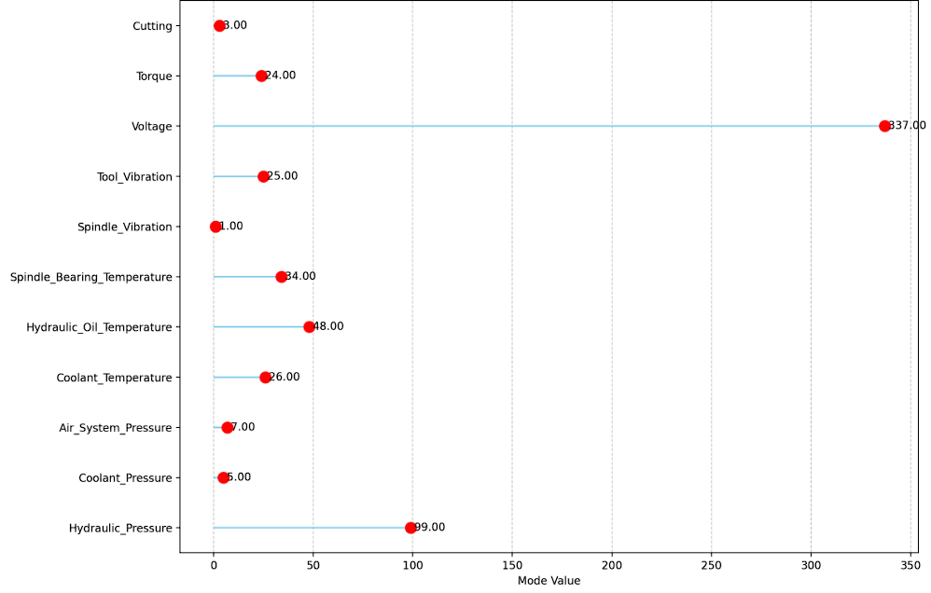
Data Visualization
Voltage Dominance: The Voltage mode value (337.00) is significantly higher than other parameters, indicating its critical role in system operation.
Hydraulic Pressure Importance: Hydraulic Pressure has the second-highest mode value (99.00), highlighting its consistent contribution.
Clustered Low Values: Most parameters, like Torque (24.00) and Coolant Temperature (26.00), have mode values below 50, suggesting operational stability.
Minimal Variability: Parameters like Spindle Vibration (1.00) and Air System Pressure (7.00) reflect baseline or minimal expected values.
Maintenance Insight: These mode values can serve as benchmarks to monitor performance and identify anomalies.
Notes:
Add graphical

Slide 15


